Slide 1
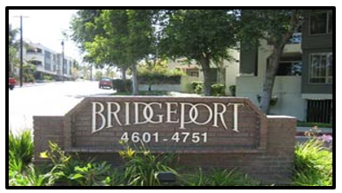
Town Hall #2 – June 1, 2022
PROJECT OVERVIEW

Slide 2

Agenda for this meeting
Introduction to Design Build Associates
Project overview
What we have accomplished to date
Next steps
Questions and Answers
2
Notes:
2

Slide 3
Agenda for this meeting
Introduction to Design Build Associates
Project overview
What we have accomplished to date
Next Steps
Questions and Answers
3
Notes:
3

Slide 4
Design Build Associates
We are construction managers and consultants and have been in the construction industry for almost 40 years.
We provide our clients with the necessary checks and balances to assure a successful project considering time, quality, and cost objectives.
Our mission is to deliver the best project at the best price, on time and at budget:
  Establishing a proper scope of work
  Prioritizing necessary repairs
  Overseeing project completion in a timely manner

Slide 5
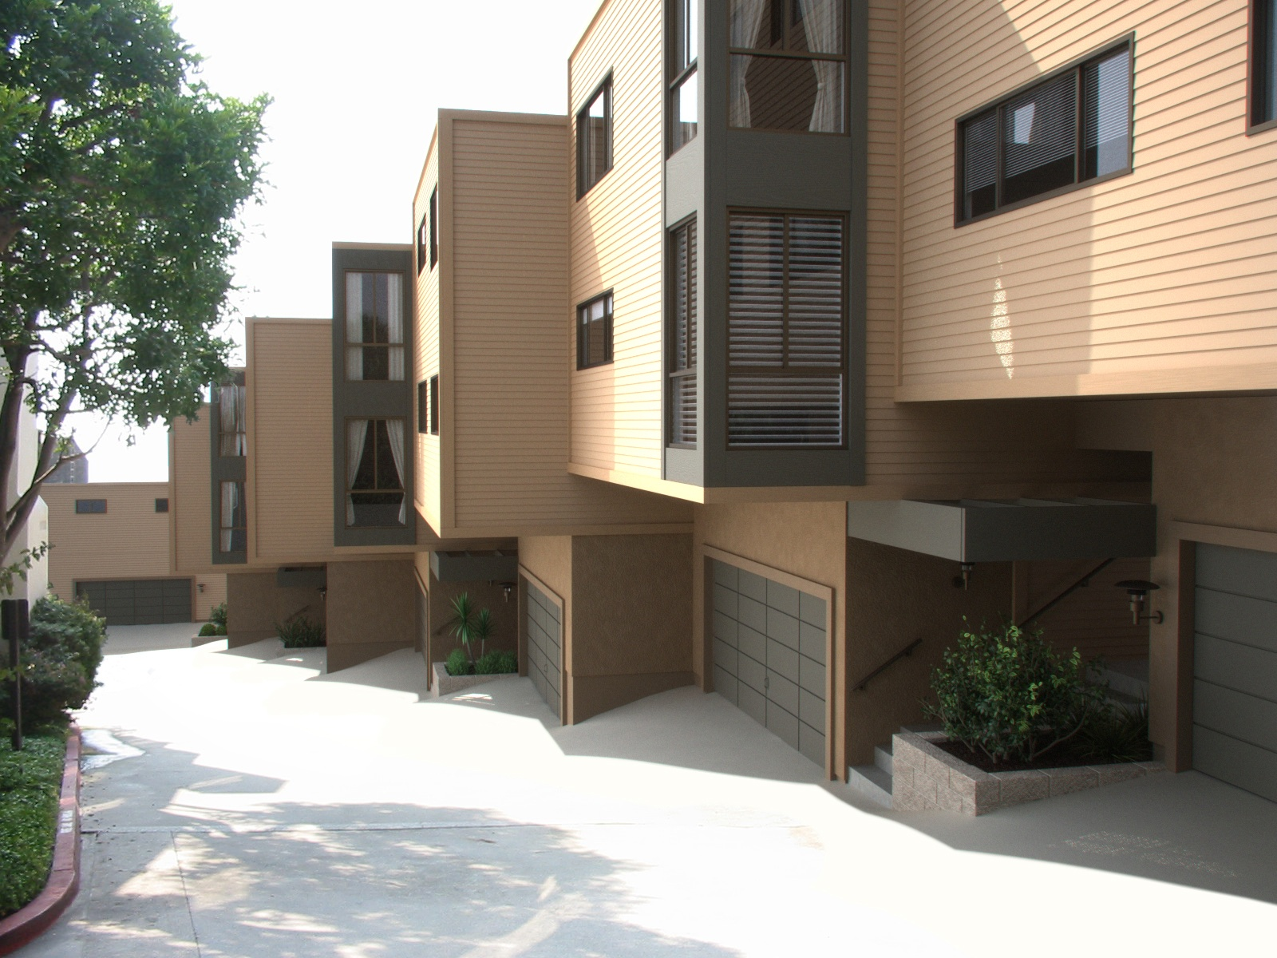
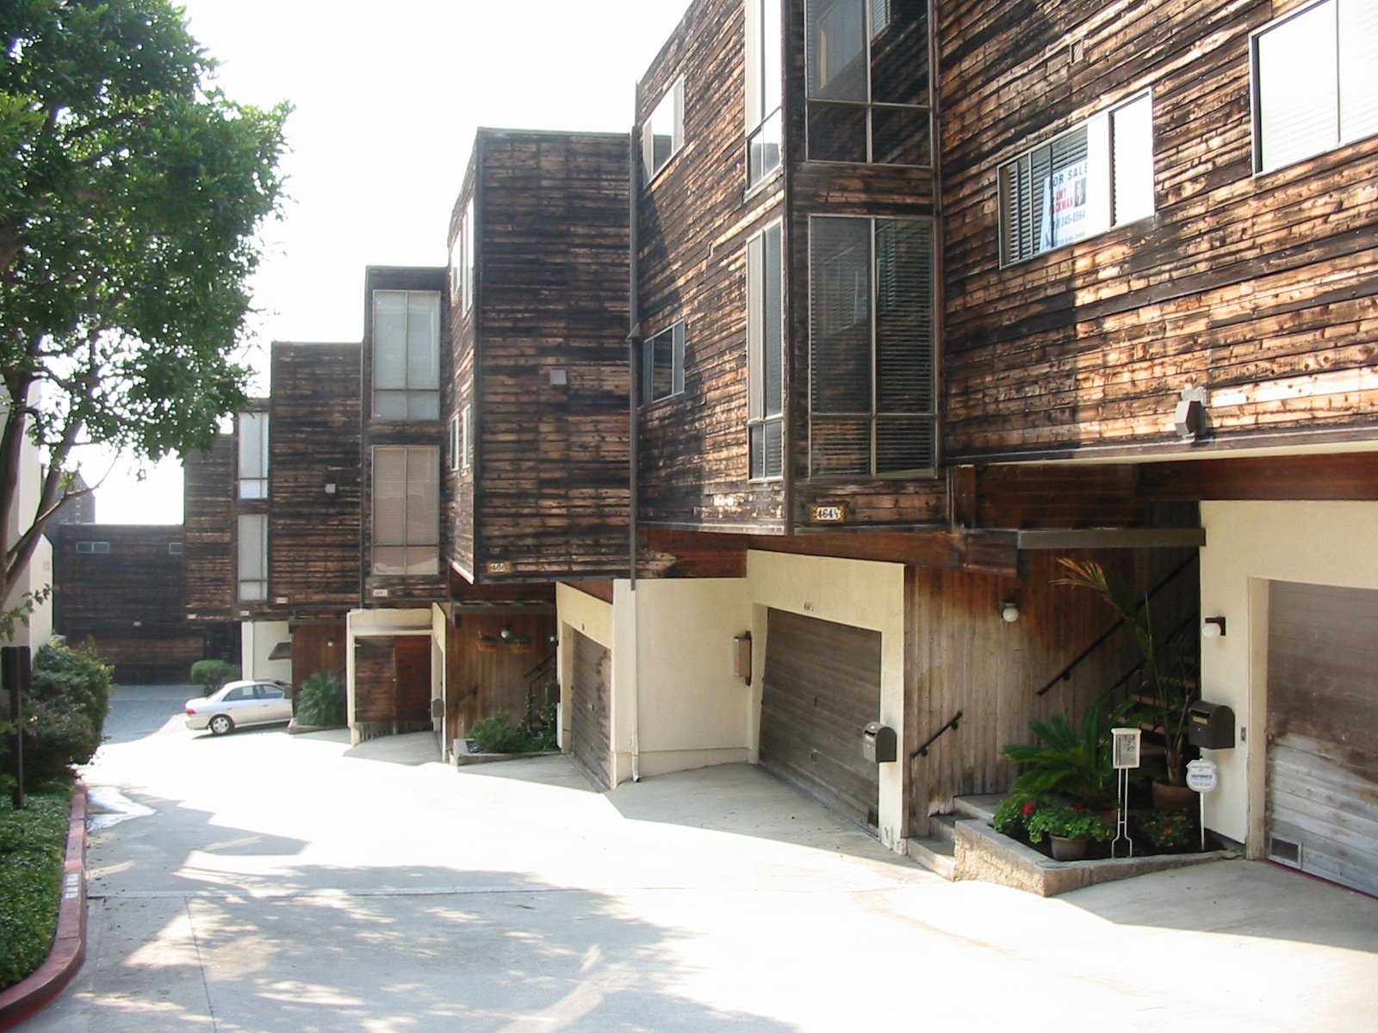
Village Palos Verdes
180 units
Major Renovation: roofs, siding, windows, more

Slide 6
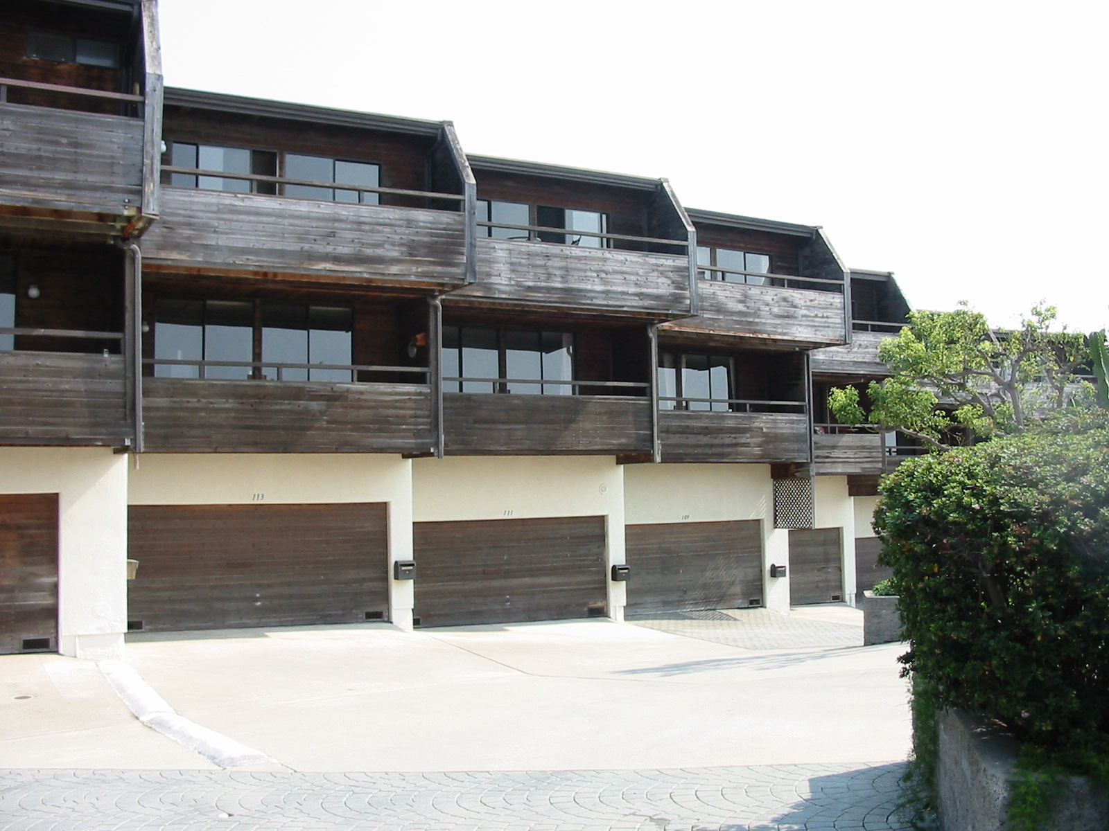
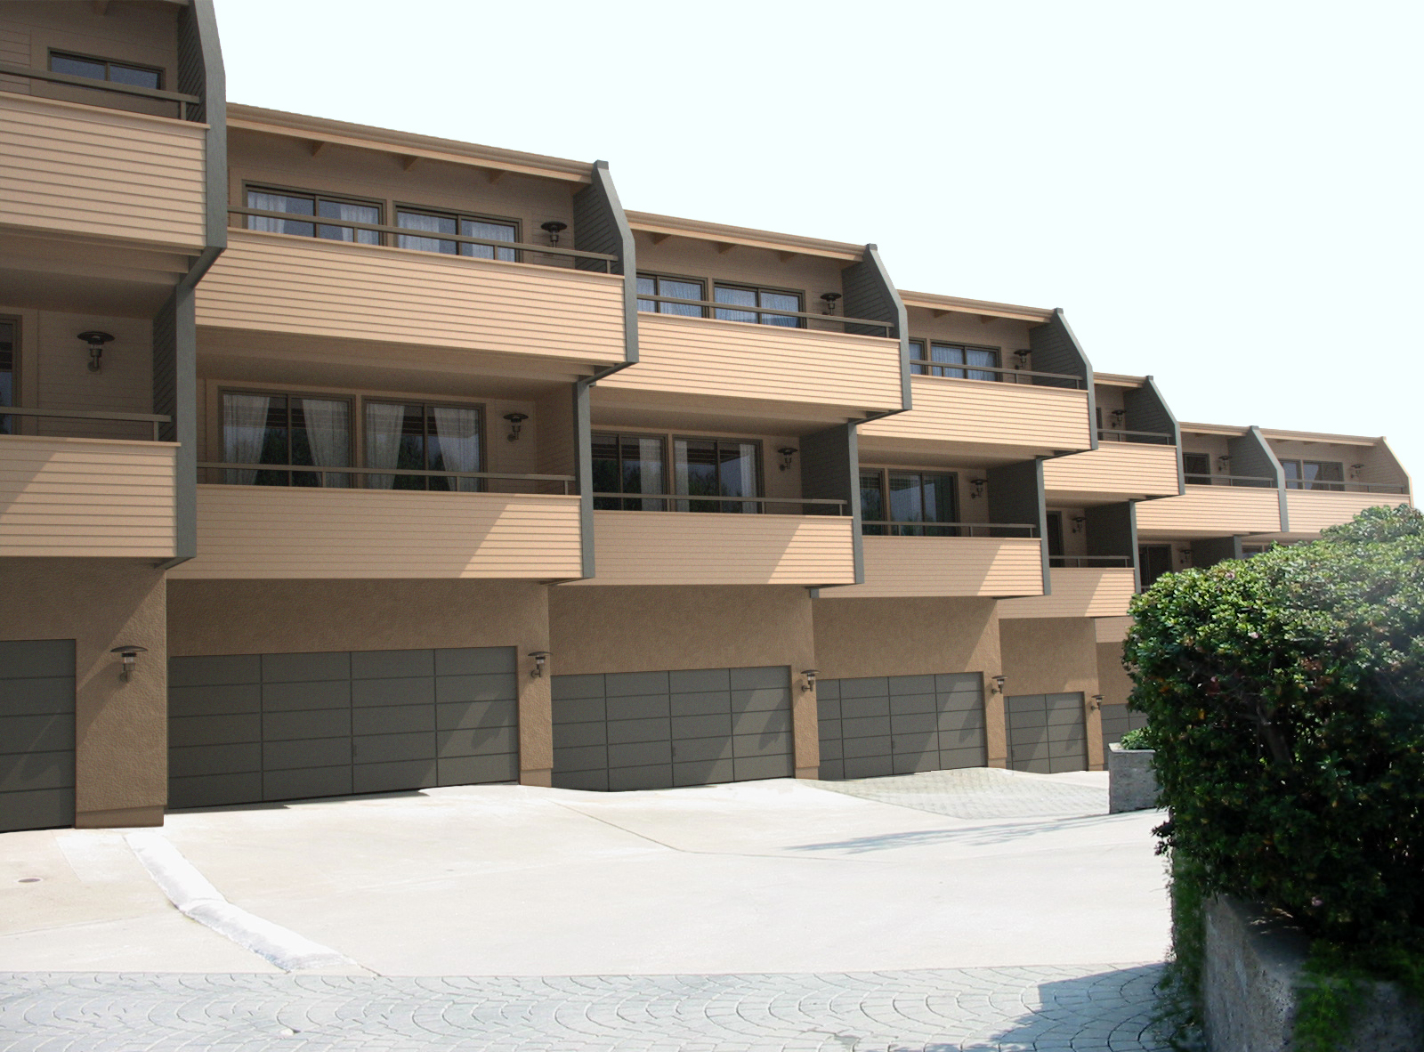
Village Palos Verdes
180 units
Major Renovation: roofs, siding, windows, more

Slide 7
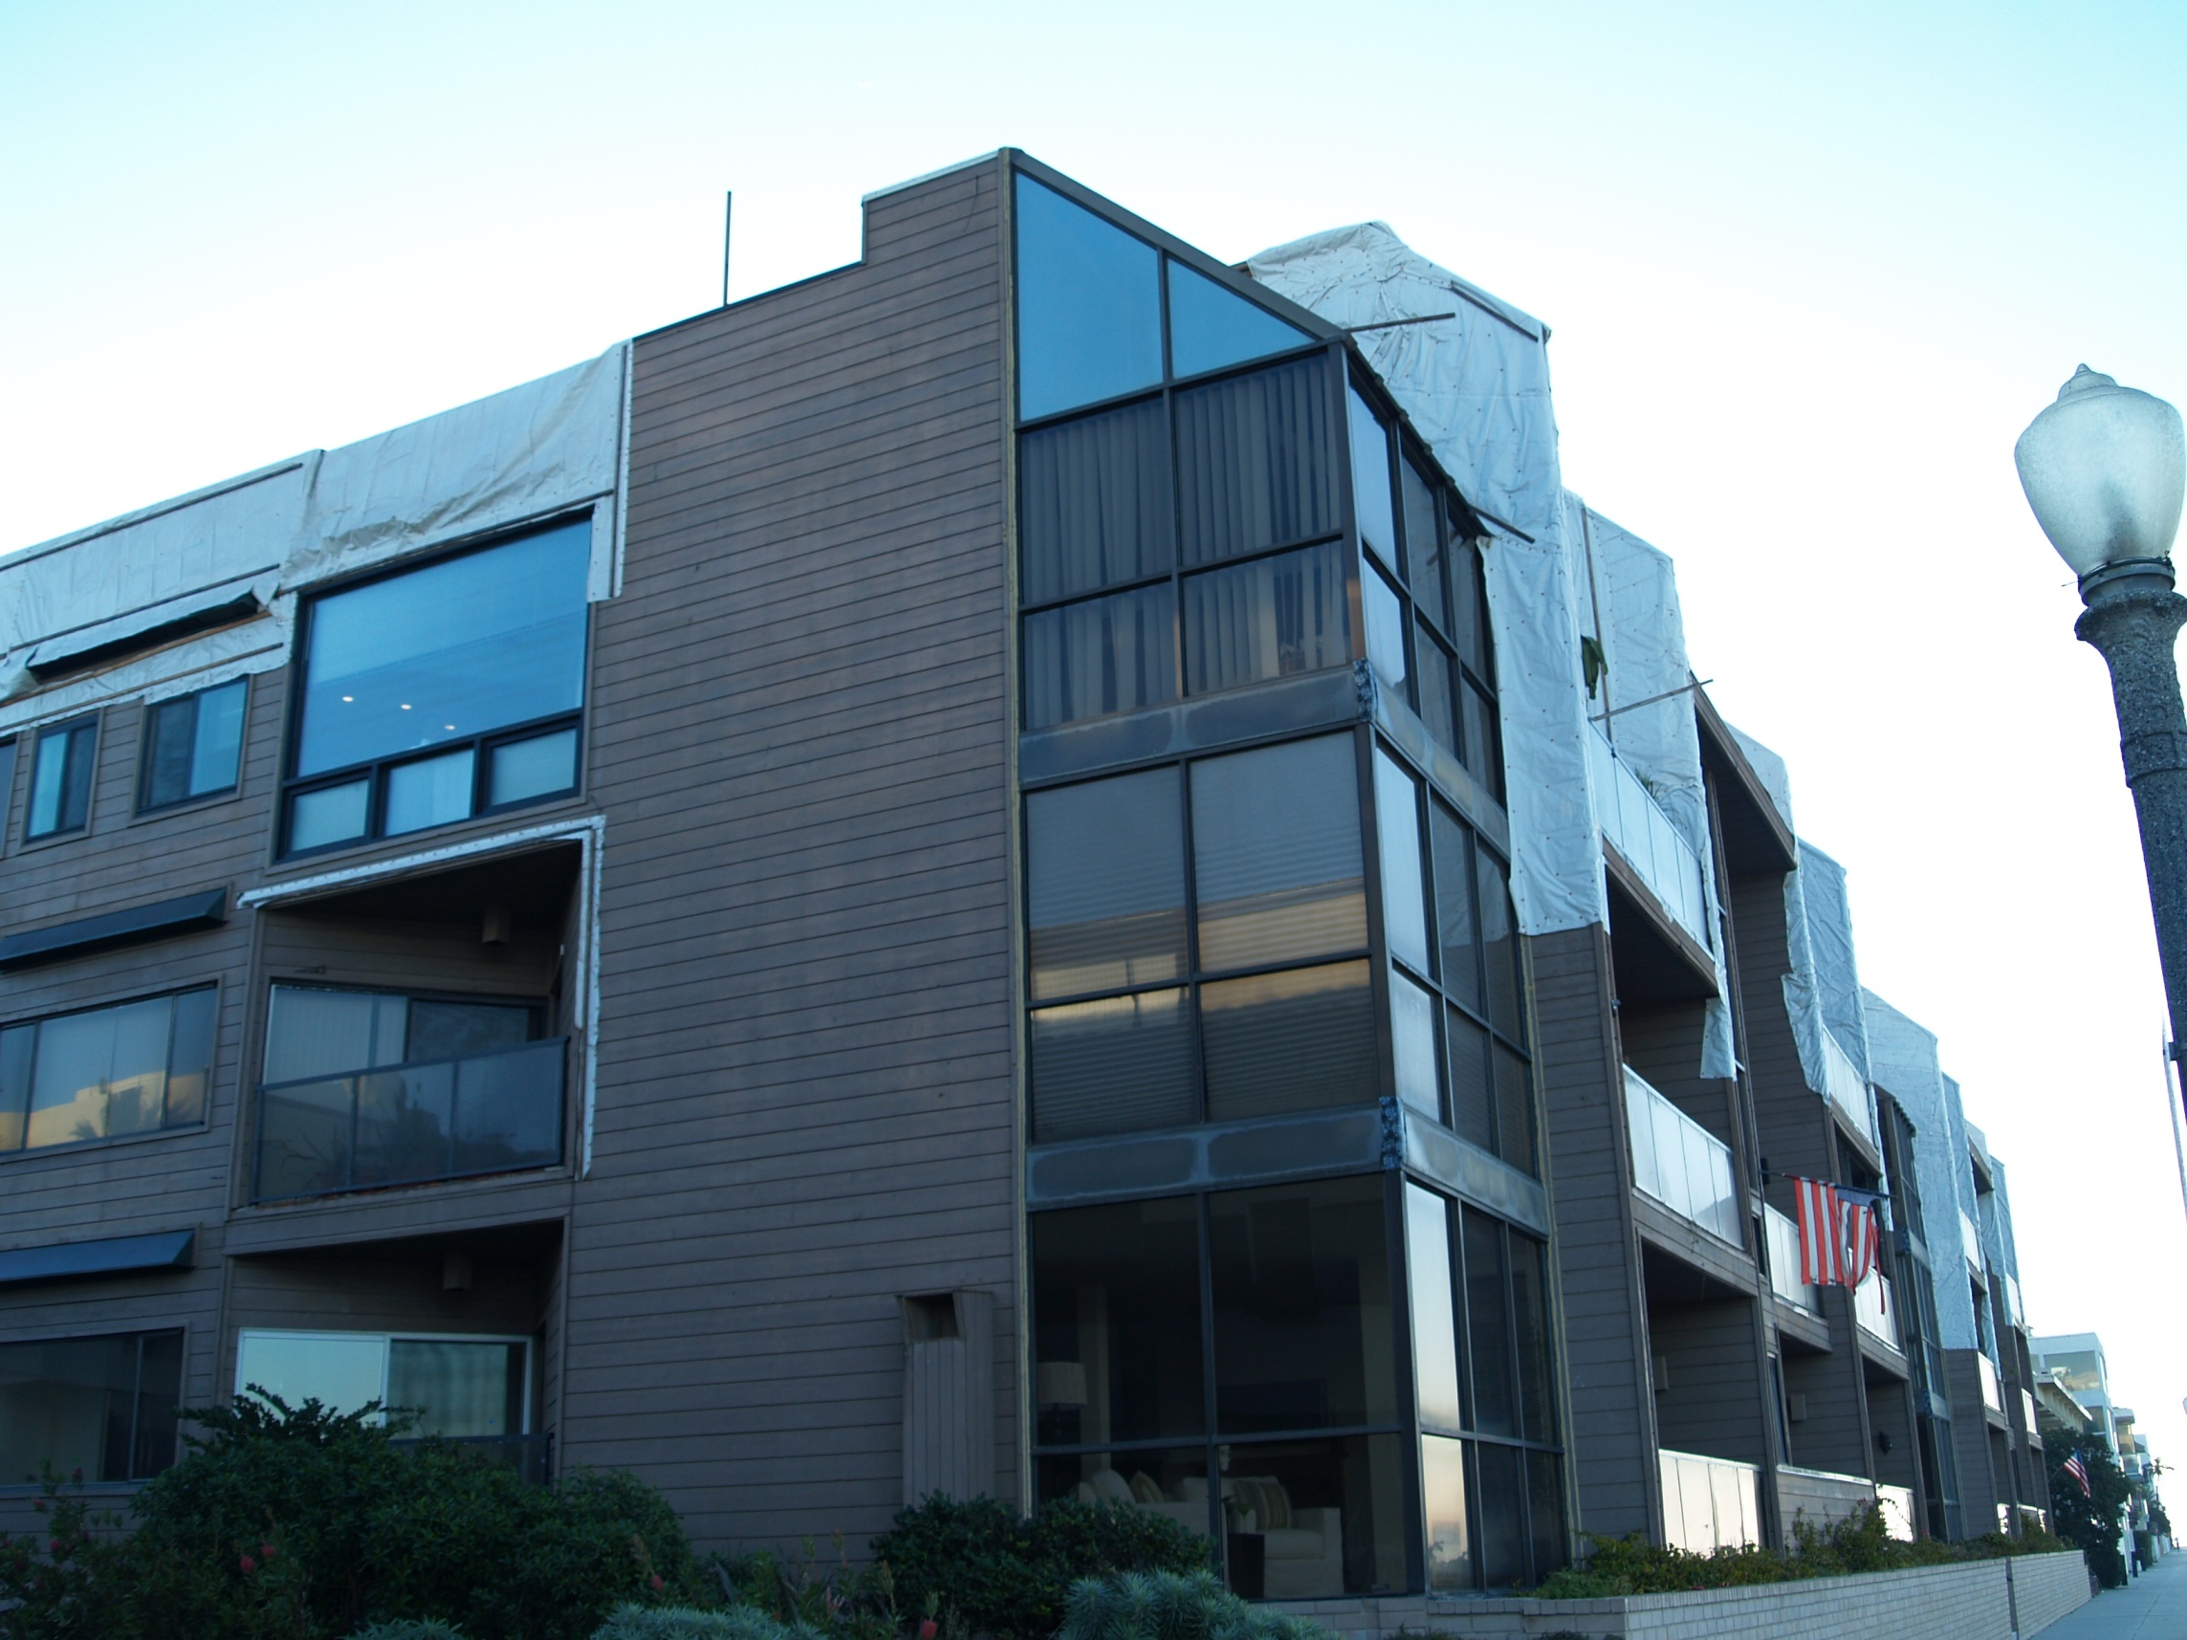
Essex House
25 units
Marina Del Rey
Before

Slide 8
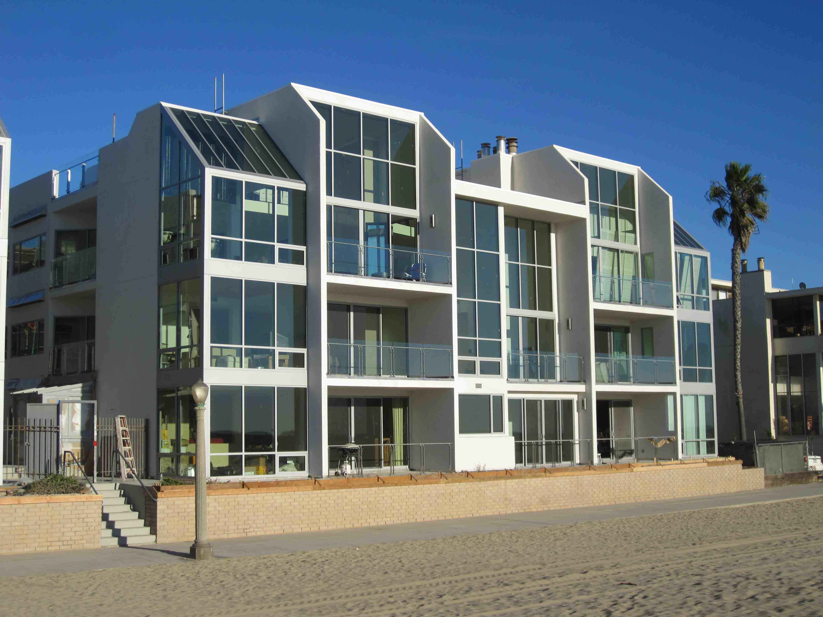
After

Slide 9
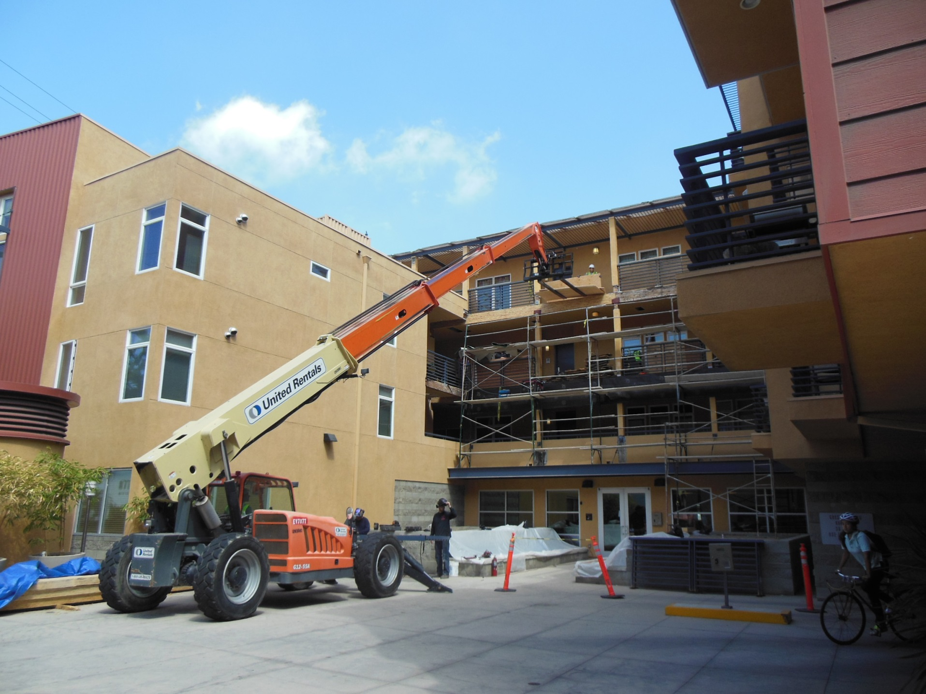
Indigo
77 units Marina Del Rey
Decking and podium waterproofing
9

Slide 10
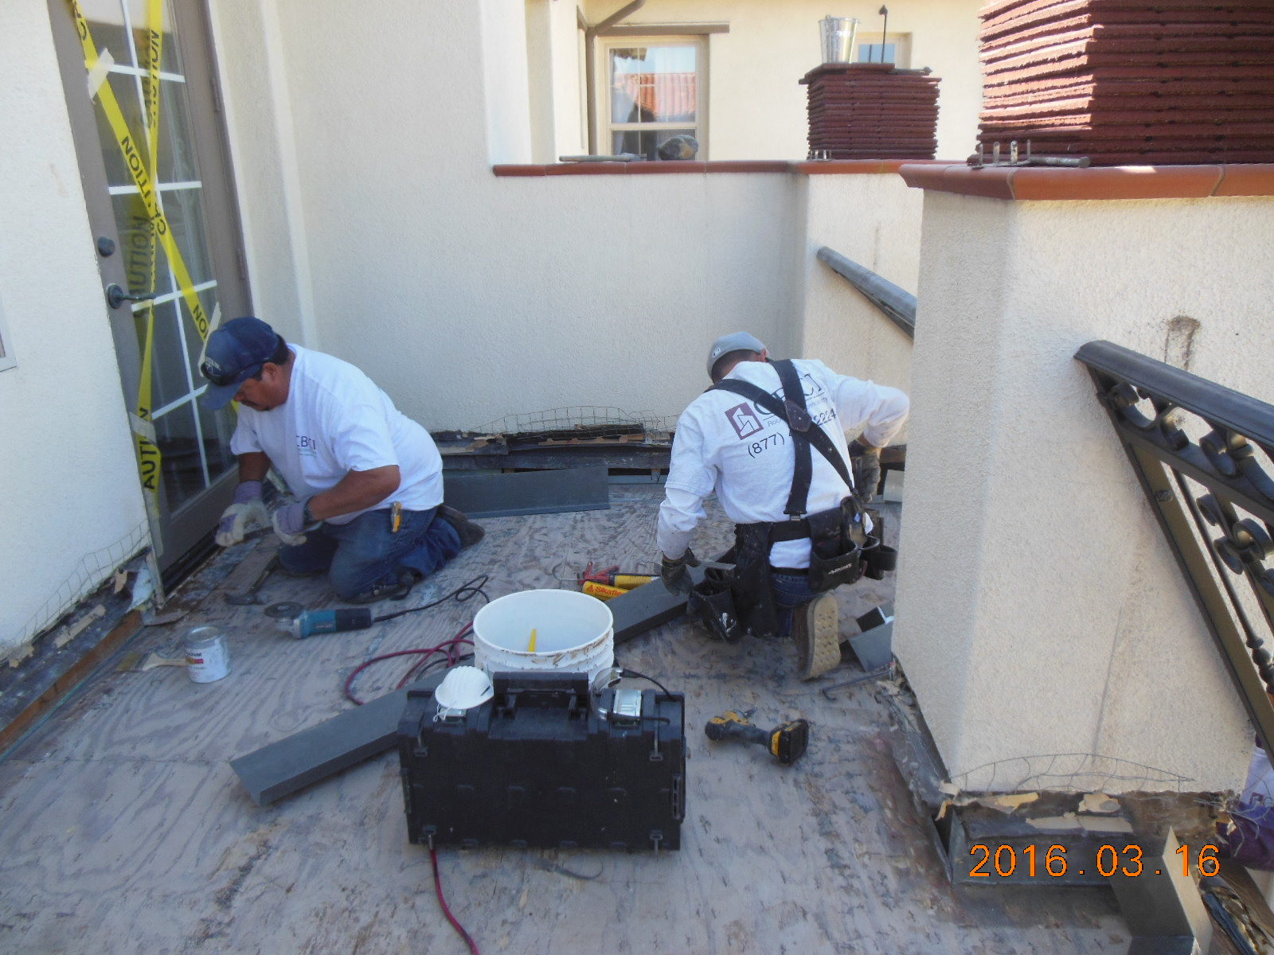
Ziani
168 Condominiums
Newport Coast
10

Slide 11
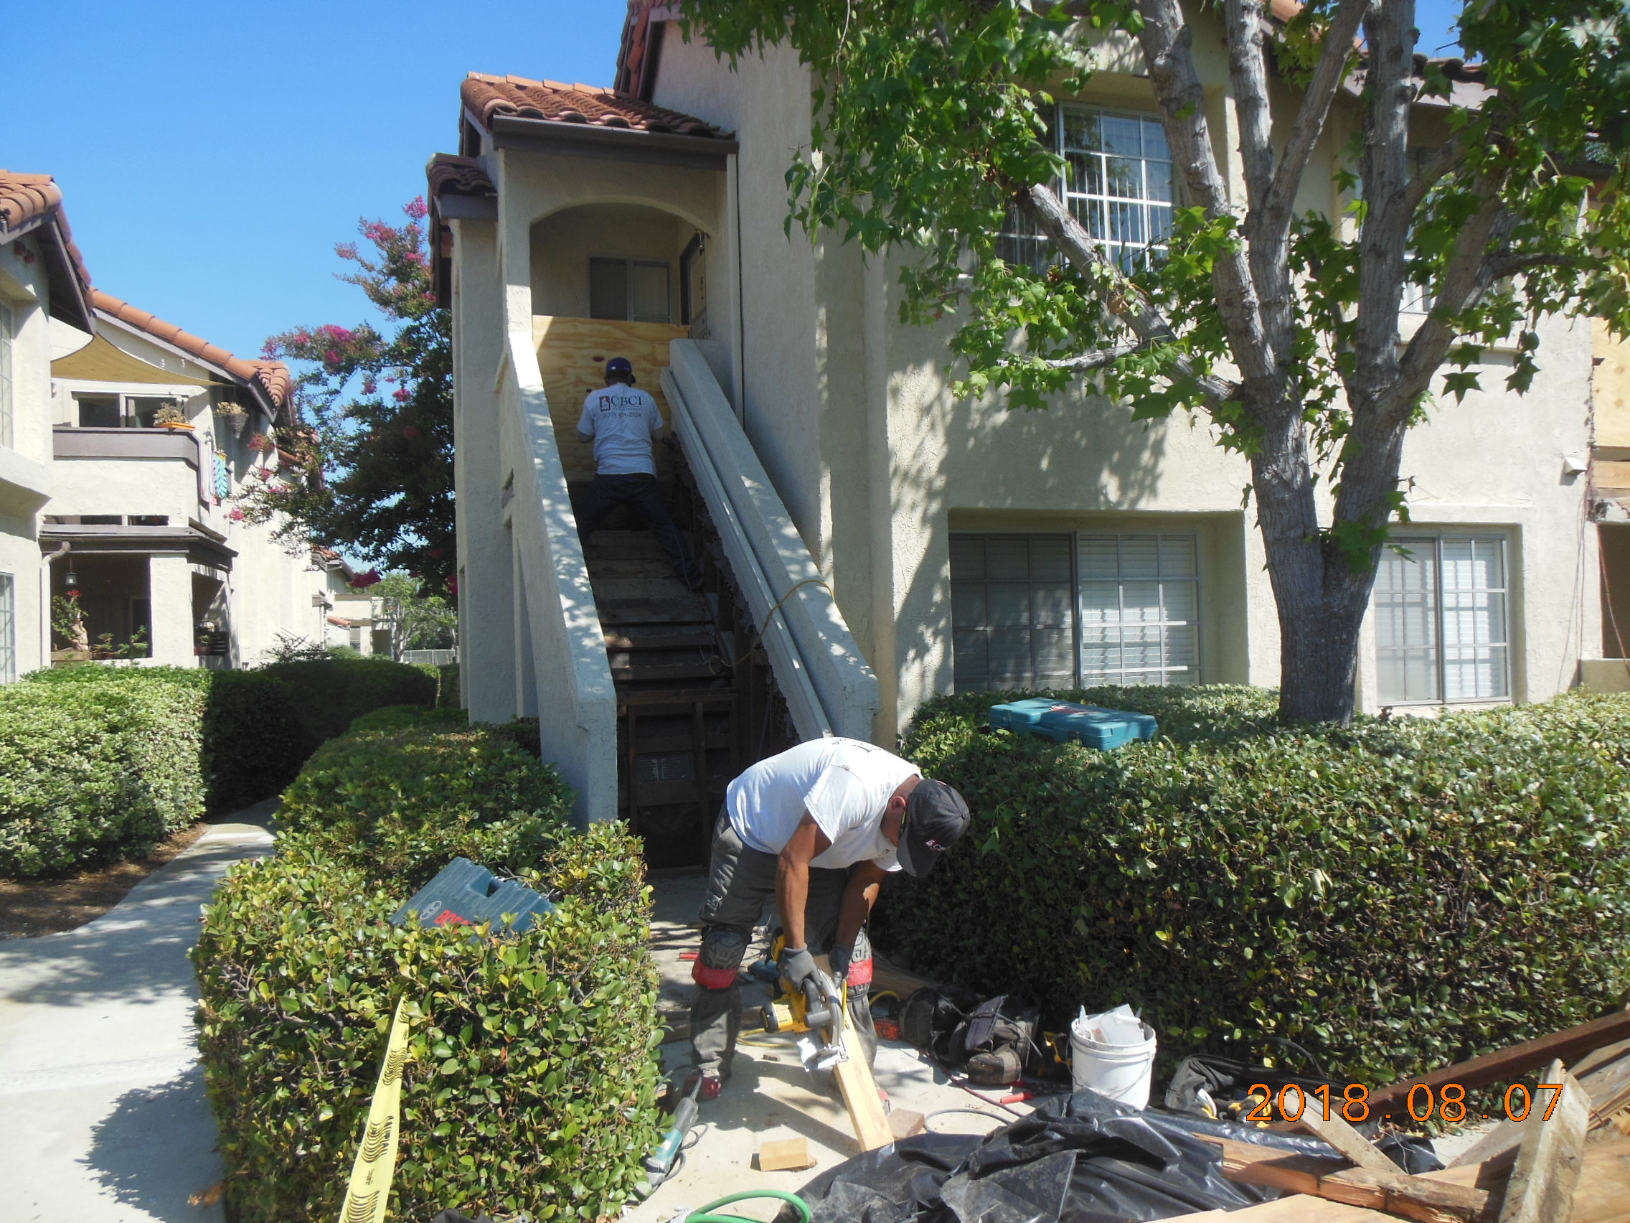
Las Palmas
405 Condominiums
Mission Viejo
11

Slide 12
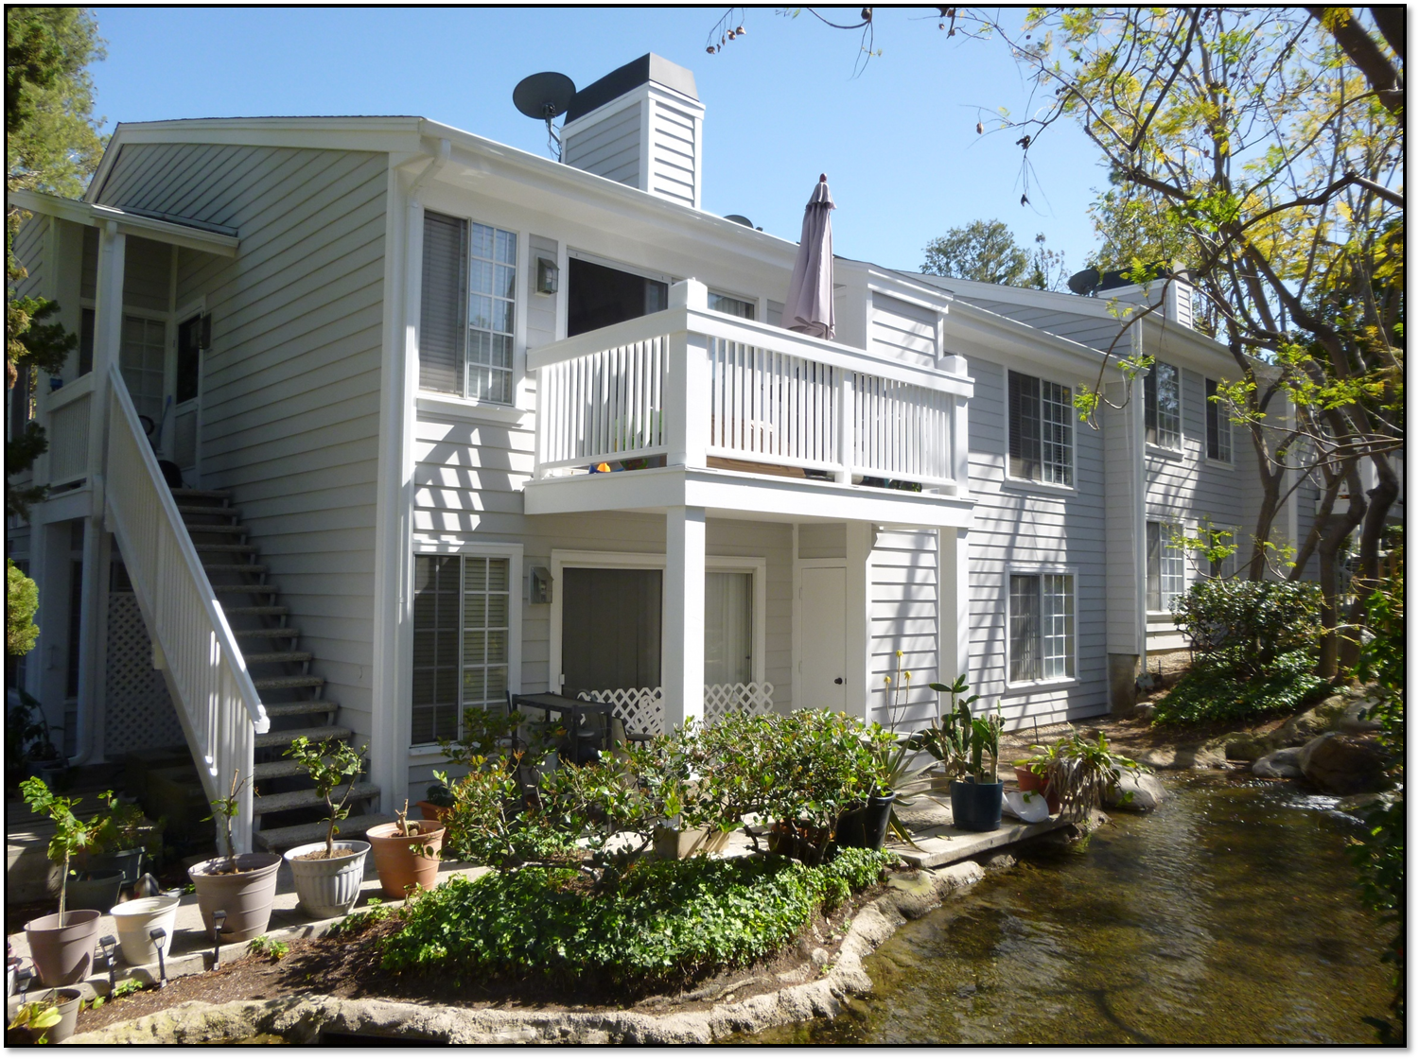


Slide 13
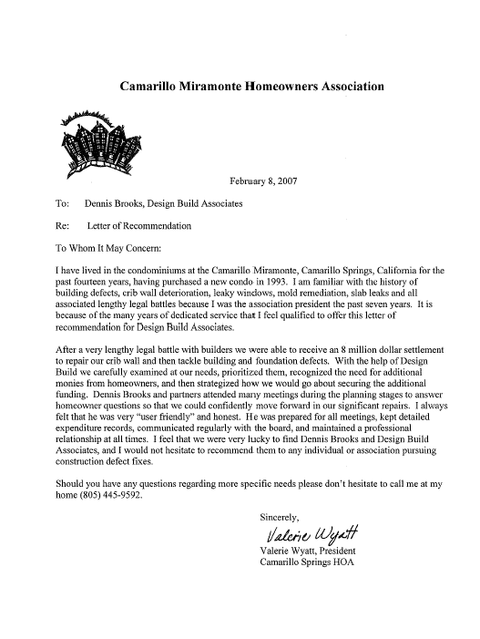

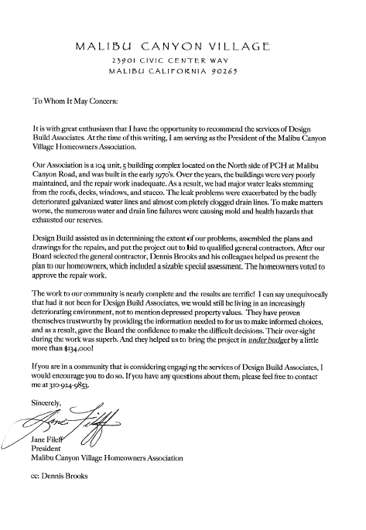
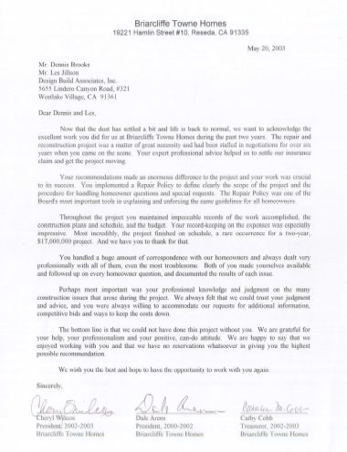
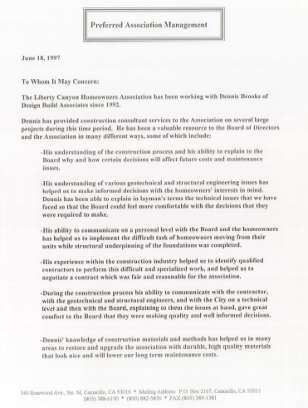
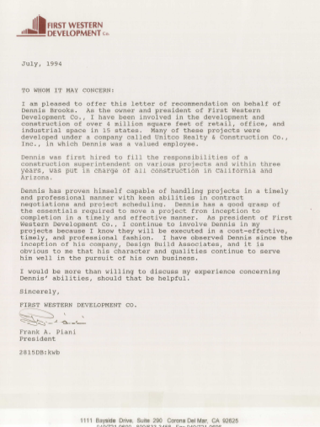
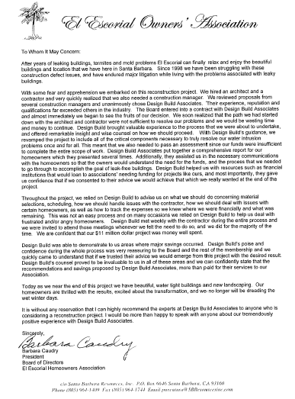
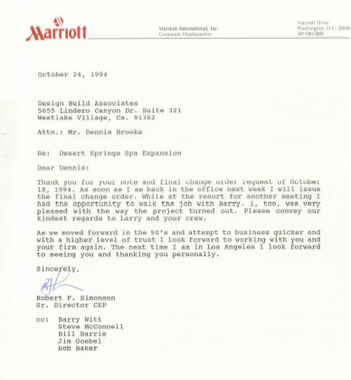
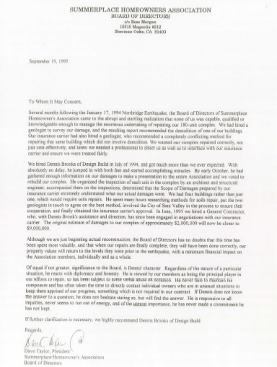
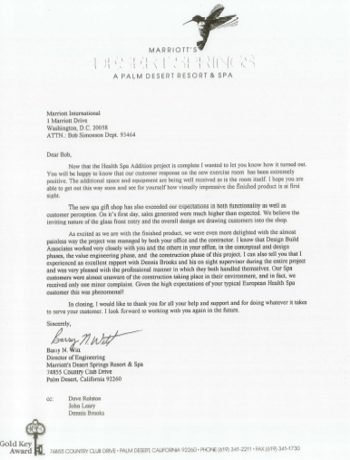
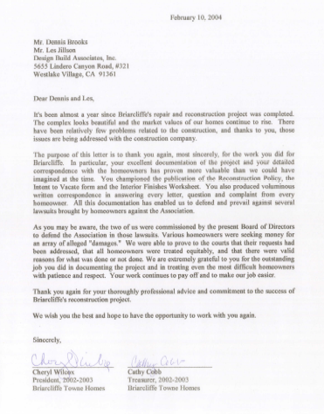
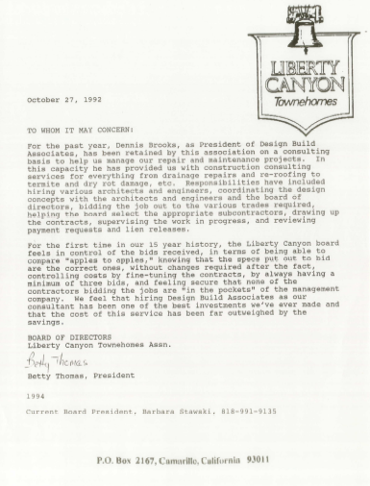
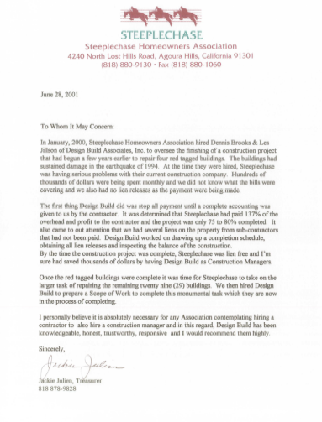
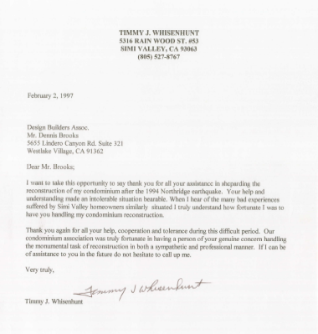
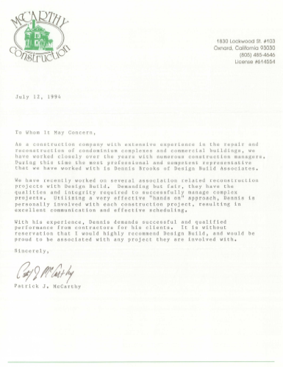
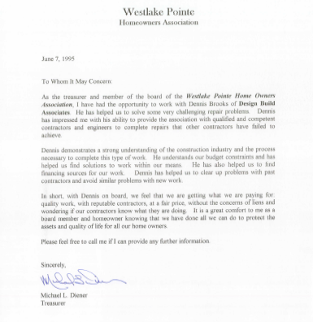
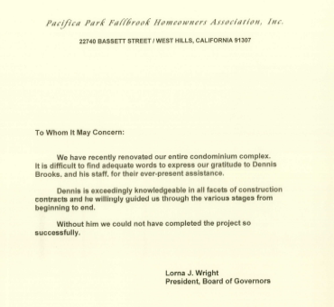
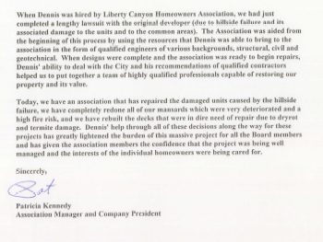
Past Clients are our best reference
www.dBuild.com
13

Slide 14
Agenda for this meeting
Introduction to Design Build Associates
Project overview
What we have accomplished to date
Next steps
Questions and Answers
14
Notes:
14

Slide 15
Bridgeport Project Overview
Damaged wood trim will be replaced.
Balcony wood repairs.
All damaged beams will be replaced, new deck coating installed on all walkways.
New wrought iron must be installed to meet Building Code requirements.
Repairs will be made to the parking garage walls and podium deck to address water intrusion issues.
All previously painted surfaces to be repainted.

Slide 16



Bridgeport Renovation Project
Pre-Construction Job Process Flowchart June 1, 2022
Initiate Project
Begin defining the Scope of Work and creating a rough cost estimate
Discuss HOA financing project. If financing is necessary:
Identify Key Lenders
Request proposals and letters of interest from Lenders
Receive Lender Proposals
Select Lender & Complete Finance Package
Sign Construction Consulting Agreement
Job walk with Account Manager from Behr Paint
Job walk with general contractor Professional Services
Project Matrix created , areas of damage identified, destructive testing proposal created
Begin Bidding Process
General Contractor applies for permits, prepares and mobilizes
Meet the Board and walk the job
Bidders identified and qualified
Pre-Bid job walks
Bid Form and Documents completed
Paint design development including virtual renderings
January Town Hall #1
DBA Introductions, Project Overview and Update
Discovery Testing approved
Request for Proposal prepared and sent to qualified Bidders
FUNDING IN PLACE, PERMIT ISSUED, APPROVALS ATTAINED, LABOR AND MATERIAL IN PLACE
Establish Client Contact and Communication Protocol
Damaged wood matrix performed and placed into spreadsheet for bid package
Discovery Testing performed followed by a team site visit for details and specification to be developed.
Received preliminary plan sets for walkways, landings and guard rails.
Formal job walks during bidding period, Requests for Information answered
Review project documentation
Assessments and mapping of garage leaks.
Finalize structural engineering plans and submit to the City Plan review
Bids received and analyzed, DBA meets with Board to recommend a General Contractor
CONSTRUCTION BEGINS
Owner Contractor Agreement negotiated
Review HOA CC&Rs and reserve Study
All Scope, Design and Specifications Finalized and Approved
HOA signs contract with General Contractor – DBA role as Construction Manager specified in contract
Legend
Bridgeport HOA
DBA
Team
Lender
Contractor
Beginning of Phase
Completed Task
Critical Path

Slide 17
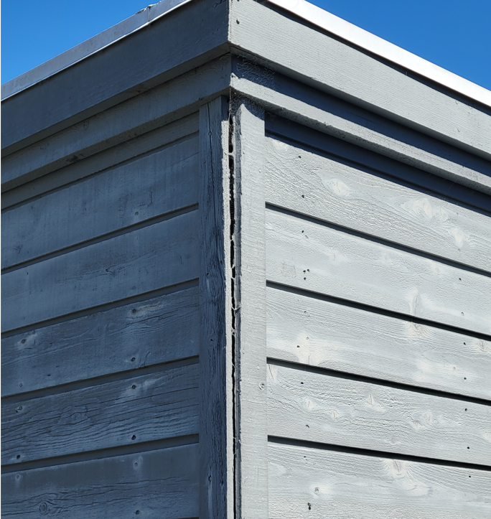
Examples of building components that need repair
Trim needs to be repaired and/or replaced.
Siding needs new paint.

Slide 18
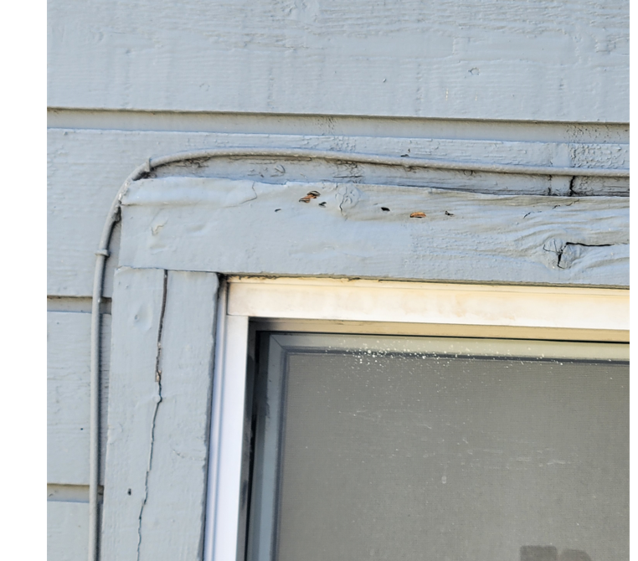
Trim needs to be repaired and/or replaced.

Slide 19
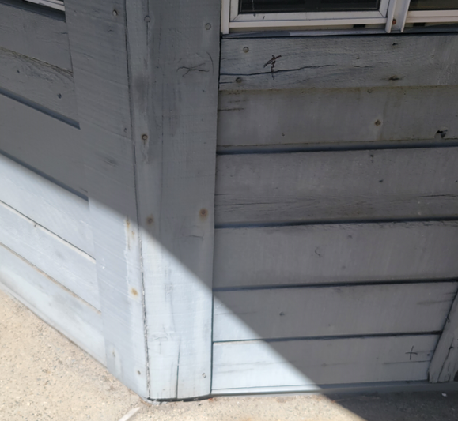
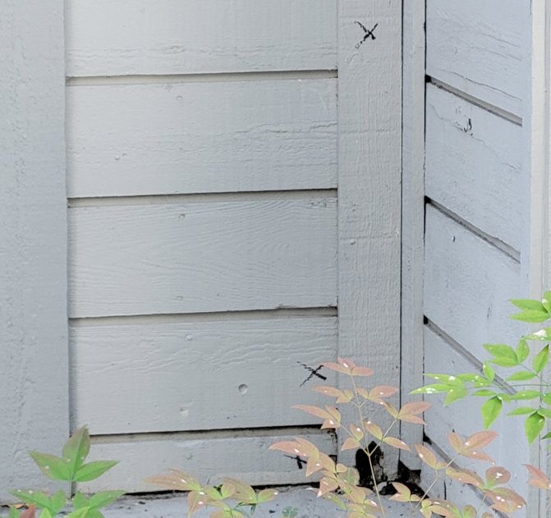
Wood trim and siding damage
Siding needs new paint

Slide 20
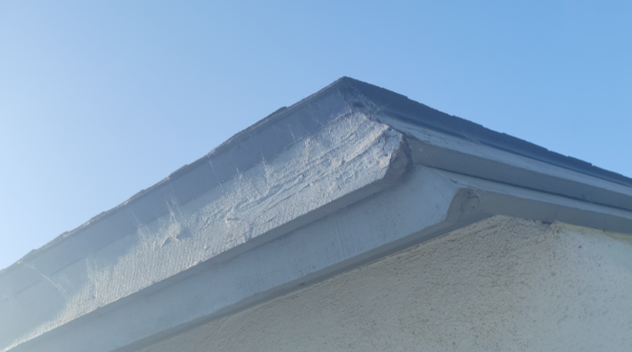
Facias need repairs

Slide 21
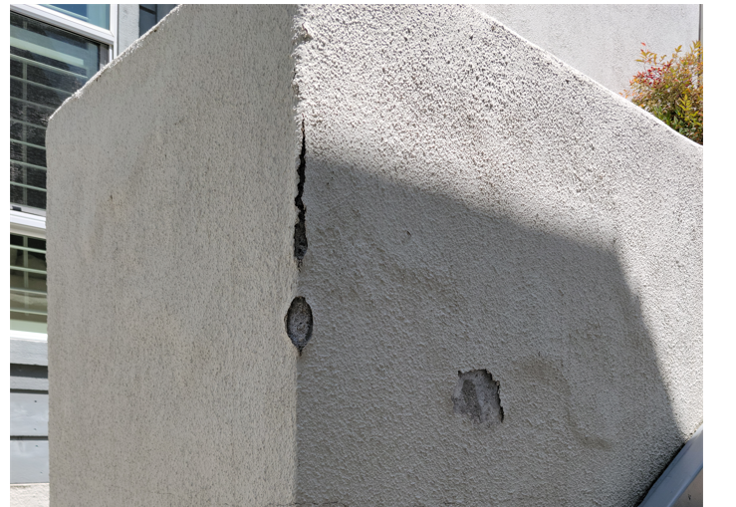
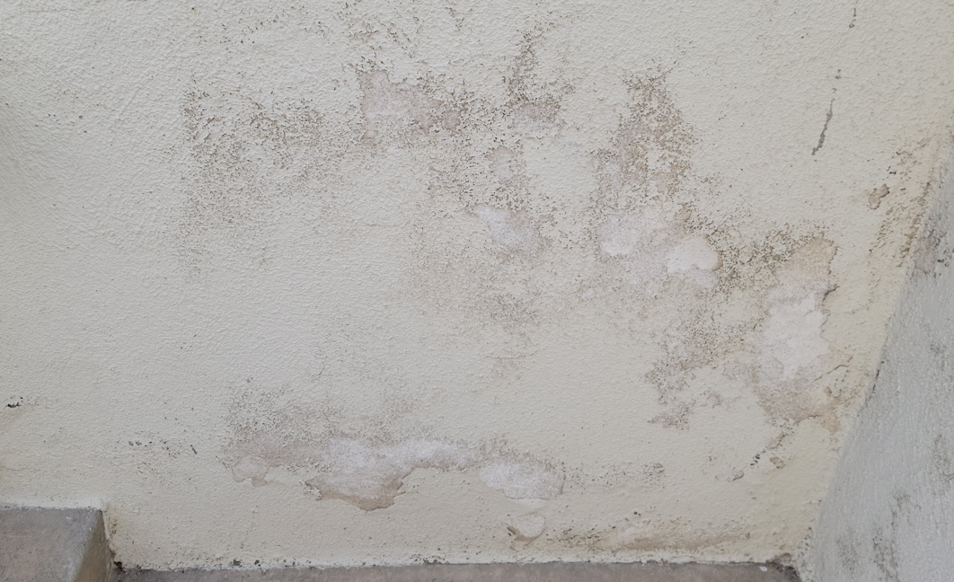
Stucco damage needs repairs and painting

Slide 22
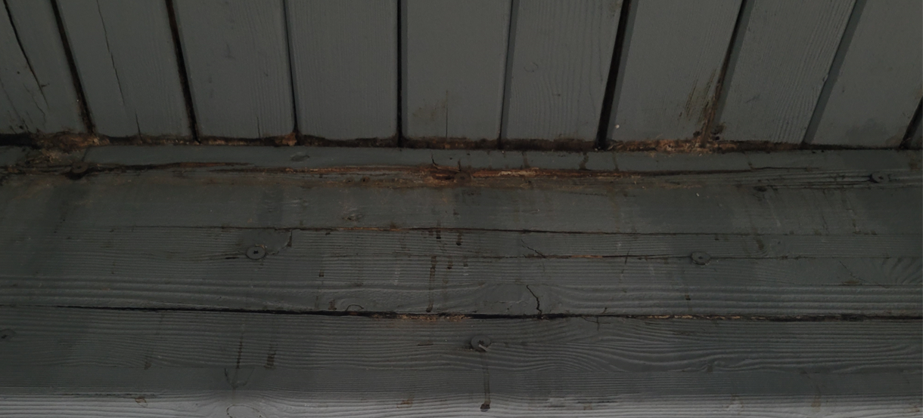
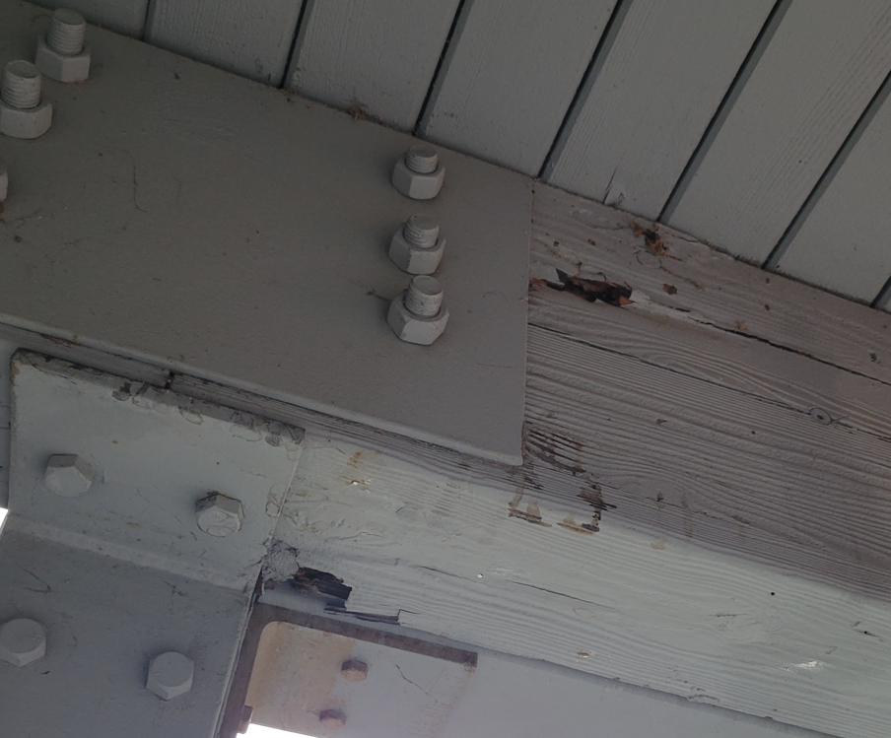
Failing structural beams need to be replaced

Slide 23
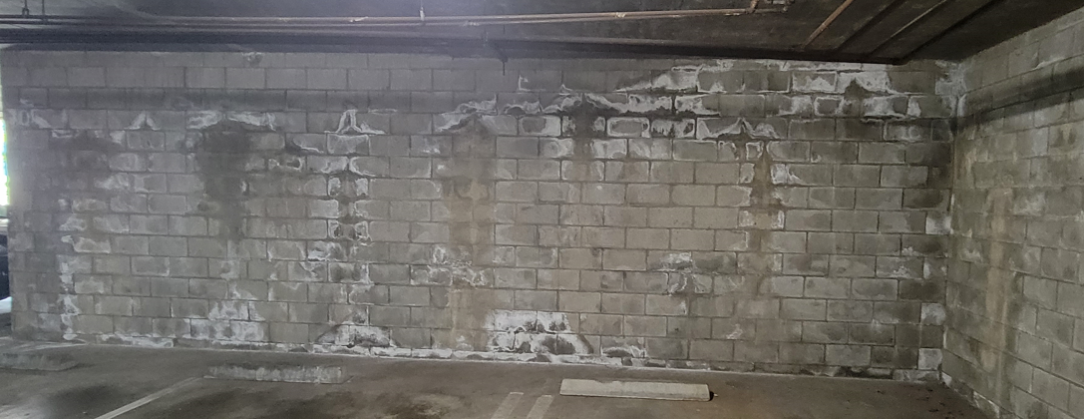
Efflorescence on garage walls due to water intrusion

Slide 24
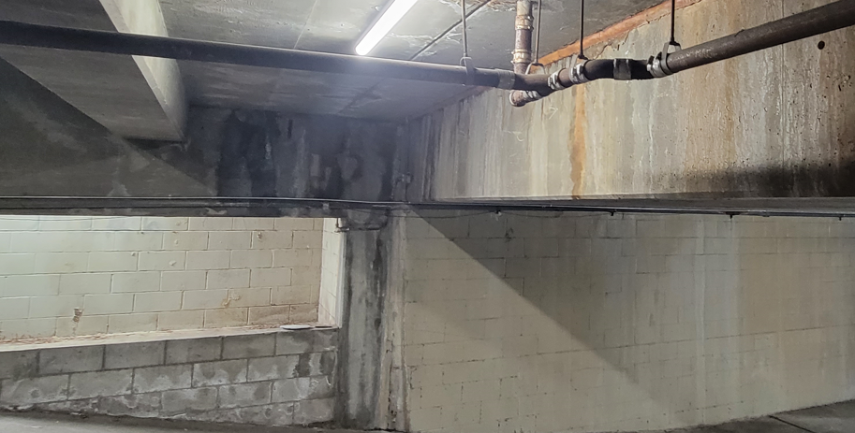
Water intrusion into the garage and associated damage

Slide 25
Agenda for this meeting
Introduction to Design Build Associates
Project overview
What we have accomplished to date
Next steps
Questions and Answers
25
Notes:
25

Slide 26
What we have accomplished to date
Developed scope of work and specifications for the project.
Worked with paint manufacturer to develop the paint specifications.
Completed environmental testing to ensure no lead is present in the existing paint.
Performed balcony inspections.

Slide 27
What we have accomplished to date (continued)
Completed discovery testing to investigate the extent of damaged beams at the elevated walkways.
Created a “Request for Proposal” detailing the scope of work and the bid documents.
We are currently finalizing the bid documents to issue to qualified contractors for competitive bidding.

Slide 28
Overview of the Bidding Process
Goal is to deliver the best product at the best price – on time and on budget.
Four qualified general contractors will be competing to perform the work.
The Scope of Work will be clearly defined in a 112-page Request for Proposal.

Slide 29
Overview of the Bidding Process (continued)
Bids are then compared “apples to apples”.
A contract between the selected contractor and the HOA is prepared for the HOA’s attorney’s review.
Design Build is involved in every step to ensure conformance to the contract.

Slide 30
Agenda for this meeting
Introduction to Design Build Associates
Project overview
What we have accomplished to date
Next Steps
Questions and Answers
30
Notes:
30

Slide 31
Next Steps – Information presented at next meeting
Finalized scope of work, including any alternates selected by the Board.
Contractor selected based on competitive bidding.
Structural plans submitted to the City for Plan Review.
Assessment to be presented to membership.
Review budget amount for project and loan.
Financing options will be explained to homeowners.
Ballots will be distributed for voting.

Slide 32
Agenda for this meeting
Introduction to Design Build Associates
Project overview
What we have accomplished to date
Next steps
Questions and Answers
32
Notes:
32

